Slide 1
Objectives
Recognize the different forms of pricing
Explain the importance of pricing
List the goals of pricing
Differentiate between market share and market position
List the four market factors that affect price planning
Analyze demand elasticity and supply-and-demand theory
Explain how government regulations affect price planning

Slide 2
SECTION 25.1 – Price Planning Issues
The Main Idea
Price is one of the Ps of the marketing mix. As such, many factors must be considered when pricing a product
“Pricing helps define a company’s image and reflects what customers expect to pay.”

Slide 3
What is Price?
The value of money or its equivalent placed on a good or service
Expressed in monetary or nonmonetary terms
$40 for a sweater or oil changes for life
Bartering
The oldest form of pricing
Still in practice today

Slide 4
Relationship of Product Value
Value is a matter of anticipated satisfaction
It is something that the customer places on an item
Seller must be able to gauge
where the product will rank
Various Forms of Price
Comes in many forms and has many names
Notes:
Price must be set high enough to make a profit yet low enough so that it does not exceed the value the customers place on the product
Forms of price
Fee you pay for the doctor to do a check up
Amount of money that you pay for a pair of shoes
Rent is the monthly price
Interest is the price of a loan
Dues are the price of membership
Tuition is the price you pay for an education
Wages, salaries, commissions and bonuses are prices businesses pay workers for their labor

Slide 5
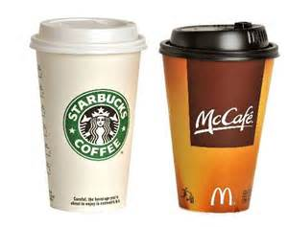
Importance of Price
Important factor in the success or failure of a business
More involved that just adding a few bucks to cost
Is a well planned strategy
Helps establish & maintain image, edge & profits
Customers use price to make judgments about products and companies
Does a higher price mean better quality?
Does a lower price mean better value?

Slide 6
Advertising strategies are closely aligned to a company’s image
Walmart uses a low-price policy and makes that its advertising strategy
Some retailers promise to beat anybody’ prices
Prices determine profits
Sales revenue = Price times quantity sold
Revenue increased two ways
Selling more items
Increasing the price of the items
Notes:
The number of items sold may not increase or may remain stable if prices are raised
It is important to remember that an increase in price can increase profits only if costs and expenses can be maintained

Slide 7
Goals of Pricing
Earning a profit or return on investment
Gaining Market Share
Meeting the Competition

Slide 8
Earning a Profit
ROI = Return on investment
Is a calculation that is used to determine the relative profitability of a product
Rate of Return = Profit / Investment
Assumptions:
You sell shirts to retailers for $9.00
Your costs are $7.50 each
(9.00-7.50)/7.50 = .2 or 20% Rate of Return
Notes:
Now let’s say that you have a ROI target of 25%, what do you do?
9.00 7.50 1.50 20% baseline
9.00 7.20 1.80 25% cut costs
9.35 7.50 1.85 25% raise price
9.20 7.35 1.85 25% raise price and cut costs

Slide 9
Gaining Market Share
Market share is a firm’s percentage of the total sales volume generated by all competitors in a given market
Market Position
Market position is the relative standing a competitor has in a given market in comparison to other competitors
Improving market share and position
Pricing
Increased advertising expenses
Change in product design
New distribution outlets
Notes:
Market share – a company may forego immediate profit in order to gain a larger share of the market. Walmart vs Toys R Us in 2009
Market position – keeping track of the changing size of a market and the growth of competitors
AVIS rental car used to be number 2 and used that are a very large part of the ad campaigns in order to become number one. “We are number 2, so we try harder”

Slide 10
Meeting the competition
Some companies aim to meet the prices of their competition
See what the industry leader is doing and price accordingly
Non-price competing factors
Quality or uniqueness of product
Convenience of business location or hours
Level of service

Slide 11
SECTION 25.2 – Price Planning Factors
The Main Idea
Pricing requires the examination of many factors. Skipping even one aspect of the pricing process could cost a business millions of dollars in lost sales, fine, and/or lawsuits
“Pricing decisions involve extensive analysis of many factors.”

Slide 12
Market Factors Affecting Prices
How does a business make pricing decisions?
Constant changes in the market place force businesses to review pricing decisions
Four key factors
Cost and Expenses
Supply and Demand
Consumer Perceptions
Competition

Slide 13
Cost and Expenses
This is where most price planning begins
Related to market conditions
The cost of raw materials may increase the cost to make the product
Sales less costs = profit
To compete, businesses must constantly monitor, analyze, and project prices and sales
Based on cost and expenses

Slide 14
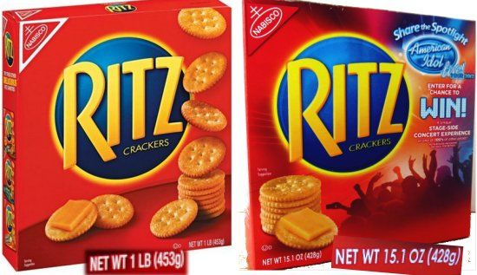
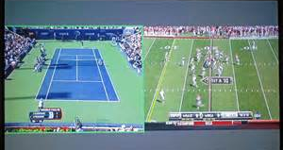
Responses to increasing costs and expenses
When the cost of doing business goes up, so do the prices
Preserving the margins
Some companies may hesitate to raise prices
Some companies will drop features in order to cut costs
Some companies will add features to justify the cost

Slide 15
Responses to decreasing costs and expenses
When the cost of doing business goes down, so do the prices
Increased sales
Aggressive companies will constantly be on the lookout for decreasing costs
Improved technology & less expensive materials
will net a better quality at a lower price

Slide 16
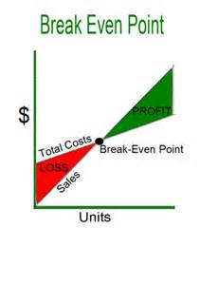
Break Even Point
Is the point at which sales revenue equals the costs and expenses of making and distributing a product
This is the point where a business begins to make a profit on the product
BE = Total Costs / Price
Assumptions:
You plan to make 100,000 toys
Selling price is $6.00
Costs & Expenses are $4.50
450,000 / 6 = 75,000

Slide 17
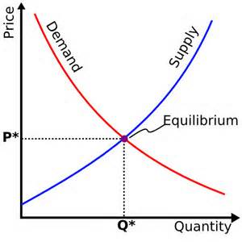
Supply and Demand
Notes:
Demand goes up when the price goes down
Demand goes down when the price goes up

Slide 18
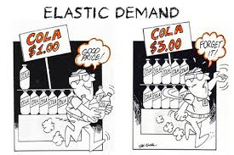
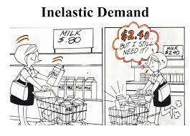
Types of Demand
Elastic Demand
Demand changes with the price
Law of Diminishing marginal utility
Consumers will only buy so much of a products regardless of how low the price goes
Inelastic demand
Demand does not change with the price

Slide 19
Factors influencing demand elasticity
Five factors determine whether demand is elastic or inelastic.
Brand loyalty
Some customers will not accept a substitute (inelastic)
Price relative to income
Price increase is significantly relative to income (elastic)
Availability of substitutes
Plenty of substitutes (elastic)
Luxury vs necessity
Medicine (inelastic)
Toys (elastic)
Urgency of purchase
Immediate purchase needed (inelastic)

Slide 20
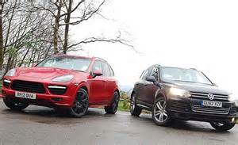
Consumers Perceptions
High price reflects high quality
High price suggests status, prestige, & exclusiveness
Producer may limit the quantity
Provide personalized service
A five star restaurant vs a burger place

Slide 21
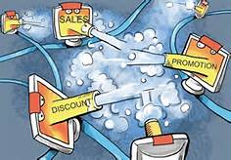
Competition
Price competition for the price conscious target market
Nonprice competition for the non price conscious target market
Non price competition minimizes price as a reason to purchase
Prices are changed to reflect consumer demand and competition
Competitors watch each other very closely
Price war
Notes:
A company can use a lower price when its target market is price conscious.
When its target market is not price conscious they can resort to various forms of non price competition
Price wars are good for the consumer – companies lower their prices to attract them
2009 Amazon, Walmart and Target all tried to attract customers with $9 books
Consumers won, but publishers and retail book stores lost

Slide 22
Legal & Ethical Considerations for Pricing
Marketers must be aware of their rights and responsibilities regarding pricing practices
Laws have been passed that must be followed
Price Fixing occurs when competitors agree on certain prices for the same products
Highly illegal because it eliminate competition
1890 Sherman Antitrust act
Notes:
Price fixing can only be proven when there is evidence of collusion or communication among competitors to establish price ranges. Price fixing is illegal because it eliminates

Slide 23
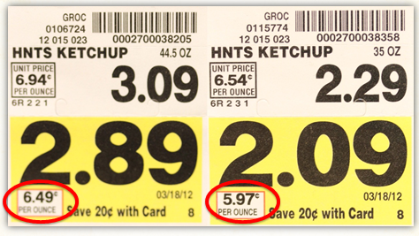
Price Discrimination occurs when a company charges different prices to similar customers in similar situations
1914 The Clayton Antitrust Act
1936 The Robinson-Patman Act – strengthened the Clayton Act
Helped smaller retailers to compete with the large chain stores
Unit pricing allows consumers to compare
Same product
Different sizes
6oz for $.64 or 12oz for $.89
Per quart cost?
Notes:
.64/6 = 10.66 cents per ounce
.89/12 = 7.41 cents per ounce
Cost per quart
10.66 * 32 = 3.41
7.41 * 32 = 2.38

Slide 24
Resale Price Maintenance
Manufacturers would set the retail price
Retailers would be forces to sell it at that price
Would not get discounts or allowances
And would also be denied future deliveries
1975 Consumer Goods Pricing Act
MSRP
Manufacturers Suggested Retail Price
Can not coerce or force retailers to sell at that price

Slide 25
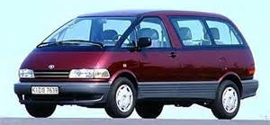
Unfair Trade Practices
Also known as Minimum Price Law
Prevents large companies from selling their products at very low prices – sometimes below cost
Loss leader
A product that a business takes a loss on in order to get the customer into the store
hopes that they will buy more stuff at regular price

Slide 26
Price Advertising
FTC developed strict guidelines for advertising prices
Reduced price can only be advertised if the original price was offered to the public for a period of time
Bait and Switch
Get the customer in the store and then switch them to a higher priced item
Notes:
Regular prices must have been offered to the public for a reasonable and recent period of time in order for a business to say that the price has been reduced.

Slide 27
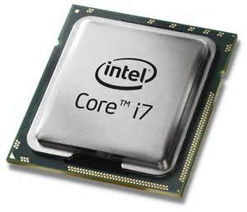
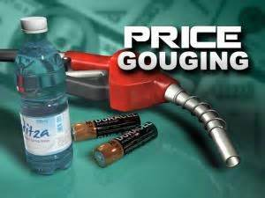
Pricing Ethics
Selling price compared to production cost
Add in R&D costs and it is not so out of line
Price gouging
Setting the price higher than usual because of a spike in demand
Plywood prices before a hurricane
Hotel rooms after a natural disaster

