Slide 2
Employment Relationships
What You Will Learn:
How to define employment-at-will
How to identify those situations that fall outside the doctrine of employment-at-will
How to identify the exceptions to the employment-at-will
How to distinguish between implied contract and implied covenant
Why It Is Important:
Understanding the nature of at-will employment will help you determine whether your rights have been violated if you are discharged by an employer

Slide 3
Employment-at-Will
Employer is able to let go of an employee at any time for any reason without notice
Employee is able to leave at any time
Unionized Employees
Union is an organization of employees that is formed to promote welfare of its members
Collective bargaining agreement is a contract negated by the employees’ representatives and agreed by the employees

Slide 4
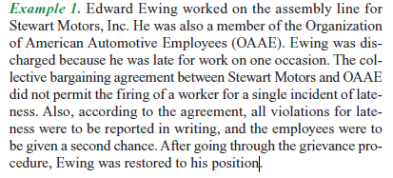
Collective bargaining agreement
Contract negotiated by the employer and representatives of the labor union and it covers issues related to employment
It normally relates to working conditions, wages, benefits, job security, layoffs, and firing policies
Grievance Procedure
A series of steps that an employee must follow to appeal the decision of an
employer who may
have violated

Slide 5
Layoffs & Plant Closings
Economic conditions can cause layoffs and closings
Severance Pay
A set of amount of money to compensate employees for being let go
Helps the employee though a time when they are unemployed
Calculated by the job position and salary
Worker Adjustment and Retraining Notification (WARN)
Must give employees 60 days advance notice of factory shut down or massive layoffs

Slide 6
Illegal Discrimination
Civil Rights Act of 1964
Protects people from race, color, creed, national origin, or gender
Age Discrimination Employment Act
Protects people from being fired or not hired due to age
Rights & Duties of Employers & Employees
Employers have the right to tell employees what tasks to perform and how to perform them
Employees are expected to be loyal, honest, dependable, and must abide by employer’s rules

Slide 7
Exceptions to Employment-at-Will
Wrongful Discharge also called unjust dismissal
Courts have established 5 Standards for unjust termination
Promissory estoppel
Implied contract
Public Policy tort
Intentional infliction of emotional distress
Implied Covenant

Slide 8
Promissory Estoppel
Four Elements must be proved
Employees needs to be rely upon
Employee actually relies upon that promise
Employee ordinarily not have acted or refrained from acting had it not been for the employer’s promise
Employee is in some way harmed by the employer’s failure to honor the promise
Court may prevent the employer from denying responsibility for loss suffered if all elements are proved

Slide 9
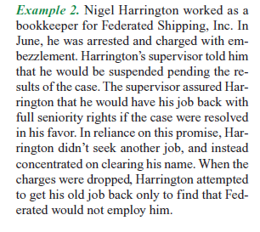
Example of Promissory Estoppel

Slide 10
Implied Contract
Employer has said, written, or done something to make the employee feel like a not at-will employee
Courts will look at the following things to determine if the employer has an implied contract
Examine the nature of the relationship
How has the employer dealt with employees in the past
Length of arraignment
Employment policies and procedures in the handbook
Disclaimer
Statement should include the following:
Handbook does not create a contract
Employer reserves the right to discharge an employee at any time
Only the highest ranking official can make the change

Slide 11
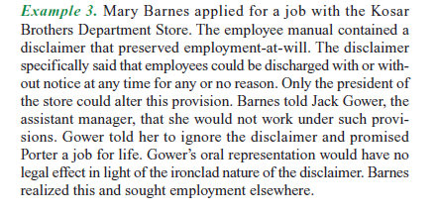
Implied Contract Example

Slide 12
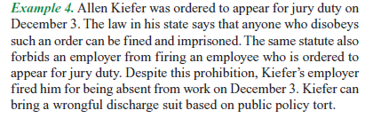
Public Policy Tort
Most states permit a fired employee to recover compensatory and punitive damages
No one should be allowed to do anything that tends to hurt the public at large

Slide 13
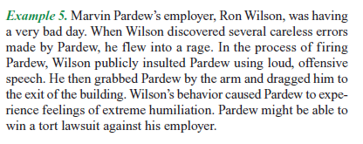
Intentional Infliction of Emotional Distress
If the layoff of an employee caused severe mental and emotional distress then the employee can bring lawsuit

Slide 14
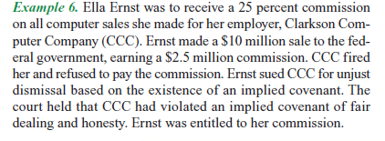
Implied Covenant
Employment relationship is based on an implied promise that the employer and employee will be fair and honest with another
This exists because the employment relationship exists

Slide 15
Reviewing What You Learned
What is employment-at-will?
What situations fall outside the doctrine of employment-at-will?
What are the exceptions to employment-at-will?
What is the difference between implied contract and implied covenant?

Slide 16
Legislation Affecting Employment
What You Will Learn:
How to recognize those areas of employment that must be included in any collective bargaining process
How to identify the objectives of the Taft-Hartley Act
How to identify the goal of the Landrum-Griffin Act
How to identify child labor laws
Why It Is Important:
You need to know the laws that protect union activities because you may be asked to join a union in the future

Slide 17
Regulating Collective Bargaining
Wagner Act
Example 7
Taft-Hartley Act
Landrum-Griffin Act

Slide 18
Regulating the Employment of Minors
State Child Labor Laws
Federal Child Labor Laws

Slide 19
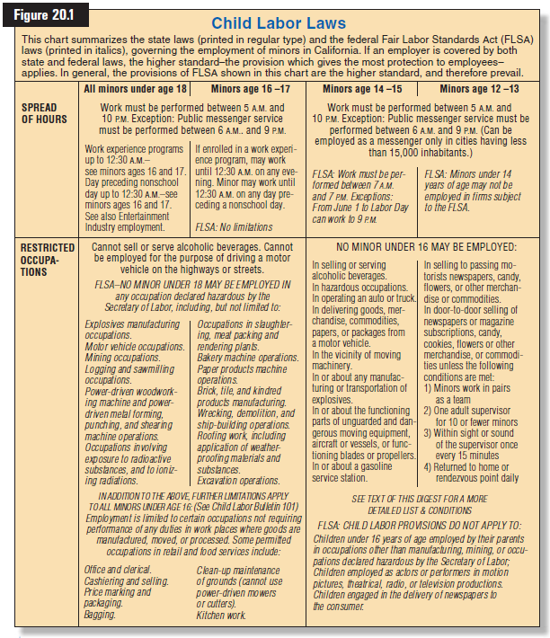

Slide 20
Industry-Education Cooperation

Slide 21
Reviewing What You Learned
What employment areas must be included in any collective bargaining process?
What are the objectives of the Taft-Hartley Act?
What is the goal of the Landrum-Griffin Act?
What are child labor laws?
Investigate and employee’s right to organize and participate in a union. Explain the legal developments that govern this right.

