Slide 1
Objectives
Explain the concept and purpose of advertising in the promotional mix
Identify the different types of advertising media
Discuss the planning and selection of media
Identify media measurement techniques
Explain techniques used to evaluate media
Summarize how media costs are determined
Explain promotional budget methods

Slide 2
SECTION 19.1 – Advertising Media
The Main Idea
Advertising is an important element of promotion. Businesses advertise to promote their ideas, goods, and services.
“Advertising is everywhere – television, radio, magazines, stores, internet, billboards, schools, sports arenas, and even on highway road signs.”

Slide 3
Advertising and Its Purpose
Advertising
Is non-personal promotion which promotes ideas, goods, or services by using a variety of media
3,000 advertising messages per day
Controlled message
Where it will be heard or seen
How often it will be repeated
Introduces new products
Change a company image

Slide 4
Promotional Advertising
Is advertising designed to increase sales
Targets consumers and B2B
Generates leads that develop into prospects
Institutional Advertising
Is advertising designed to create a favorable image for a company
Public service ads
Favorable image by supporting a cause
Does not directly affect sales
Notes:
Promotional Ads may encourage customers to ask questions, call for appointments, participate on the internet, or enter a retail store
Institutional ads attempt to make a connection with potential customers by connecting its name with a worthy cause

Slide 5
Mass Advertising
Allows companies to reach large numbers of people with their messages
TV and radio are examples of mass marketing
They can also target their messages to select audiences
Advertising demonstrates the features and benefits of a good or service
As a result, encourages buying

Slide 6
Media
Are the agencies or instruments used to convey advertising messages to the public
TYPE | EXAMPLE
Print | Newspaper
Broadcast | Television
Internet | Opt-in Email
Specialty | Giveaways

Slide 7
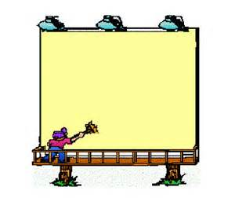
Print Media
Includes the following types of advertising:
Newspapers
Magazines
Direct Mail
Directory
Outdoor
Transit

Slide 8
Newspaper Advertising
Daily & Weekly Newspapers
1600 in the US & thousands of local papers
Allows retailer & local businesses to reach target markets
Shoppers & Alternative Newspapers
Local papers with local advertisements
National Newspapers
Allows an advertisement to reach a national circulation
Most have on-line editions
Advantages & Disadvantages
+’s known distribution, sales tracked easily, low cost
-’s one and done, less appealing, declining readership
50%
Notes:
Shoppers contain minimal editorials and are delivered to specific areas
Alternatives focus on local entertainment, movies, and restaurant reviews and alternative political comments and stories
It is estimated that only 50% of households in the US subscribe to a newspaper.

Slide 9
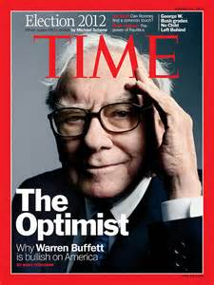
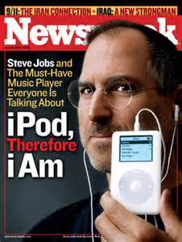
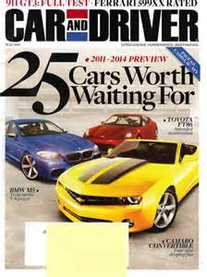
Magazine Advertising
Over 19,000 magazines distributed
Weeklies, monthlies, & quarterlies
On-line and print
Regional, state & city editions
Consumer Magazines
Designed for personal interests
Are used to target an audience
Business-to-Business Magazines
Trade publications
Interest professionals in specific fields
Reaches a target audience with little wasted circulation
Advantages & Disadvantages
+’s longer lifespan, read slower, high color quality
-’s more expensive & long deadlines
Notes:
Magazine ads offer different sizes – spread (two page), full page, half page, gatefolds, return cards, and heavy stock inserts
Long deadlines make it hard to make last minute changes due to some deadline being several weeks long.

Slide 10
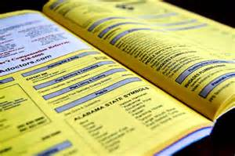
Direct Mail Advertising
A highly focused form of advertising
Printed or electronic
Keeps current customers aware of new products or upcoming sales
Advantages & Disadvantages
+’s selectivity & flexibility
-’s low response level, “junk mail” , high costs
Directory Advertising
Yellow pages
Very inexpensive
Different sizes
Targets all demographic groups
Stays the same until reprint
Notes:
Direct mail includes newsletters, catalogs, coupons, samplers, price lists, circulars, invitations to special sales and events, letters and more.
Large retailers send catalogs and price lists to current and perspective customers
DM can use may formats – letters, catalogs, and postcards – limited by postal limitations
Includes electronic campaigns as well
DM only yields a 1 to 3 percent return

Slide 11
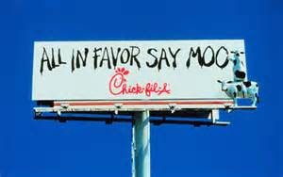
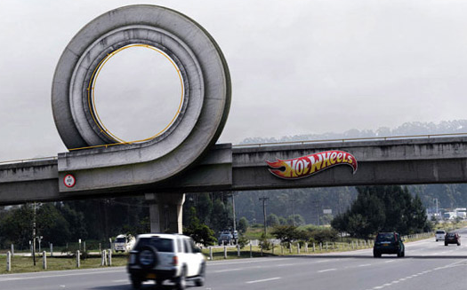
Outdoor Advertising
Can be seen from a far away
14 by 48 feet - bulletin
Smaller sizes called posters
New technologies allow for changing sooner
Advantages & Disadvantages
+’s visible and affordable
-’s limited viewing time
& regulated

Slide 12
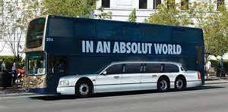
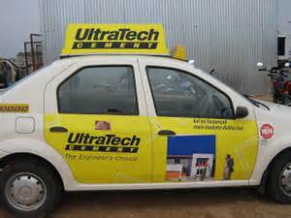
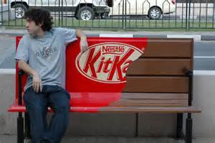
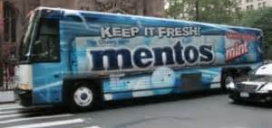
Transit Advertising
Ads seen on busses and taxies
Public benches and trains
Urban settings
Captive audience

Slide 13
Broadcast Media
Encompasses radio and television
Television
30 to 60 seconds per “spot”
30 to 60 minutes = infomercial
Combines sight, sounds, action, & color
very high cost – production and air costs
Radio
Reaches a wide audience
Extremely efficient and affordable
Targets are selected by the selection of the station
10, 20, 30 or 60 second
Jingles are very important
Notes:
1700 commercial TV stations and over 11,000 with ones included with local cable networks
By the time you are 66 years old
10 years of watching commercials – 2mm commercials viewed
6 years of listening to the radio
Superbowl is now up to $3 for airing a 30 second ad
More than 10,000 radio stations
Since there is no visuals, humor and jingles are very important

Slide 14
Internet Advertising
Advertising that uses email and the Web
A growing medium
Opt-in Email Ads
Authorized by recipients via links
Sent to prequalified groups of people – often personalized
Banner & Search Engine Ads
Rich Media & Video Ads
Podcast – a brief broadcast
Generates better brand recognition than static online ads
Social Media Advertising
Blogs are personal sites where people give their thoughts, pictures, and comments with visitors
Notes:
Internet ads have a very low response rate - .3 percent – three out of 1000 views will visit your webpage

Slide 15
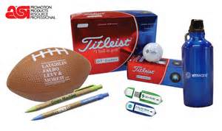
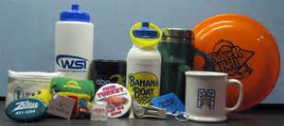
Specialty Media
Also known as giveaways or advertising specialties.
Inexpensive useful products with a company name, message or logo
To be effective
Must be practical
Used frequently
Put in places with high visibility

Slide 16
Other Advertising Media
Business are constantly creating innovative and unusual means of transmitting their messages to potential customers
Ad-supported TV screens at airports, gas stations, health clubs, and subways
Digital billboards at sports arenas
On-screen movie theatre ads
Messages in public places where people will see it.
Diaper changing stations, trashcans, bathroom stalls and elevators

Slide 17
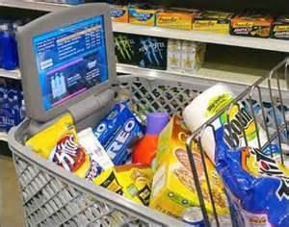
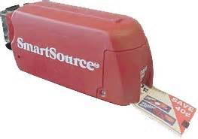
In-Store Advertising
In-store advertising used by retailers to catch your attention
Ceiling and floor graphics
Electronic shelf ads
Shopping cart ads
Instant coupon machines
Sound systems
Kiosks
New Media
Uses mobile internet to advertise

Slide 18
Media Planning & Selection
Media Planning
Is the process of selecting the appropriate advertising media and deciding the time or space in which ads should appear
Software is used that compares the costs and audience information
The 3 basic questions:
1. Can the medium present the product and the desired business image?
2. Can the desired customers be targeted with the medium?
3. Will the medium get the desired response rate.
Notes:
The media plan provides the opportunity to present a compelling message and project the desired business image to the target market

Slide 19
SECTION 19.2 – Media Rates
The Main Idea
Businesses need to reach as many targeted customers as possible. It is important to calculate cost and measure media effectiveness to reach a potential audience.
“Everyone knows that it pays to advertise, but the questions are “How well?” and “Was it worth the cost?””

Slide 20
Media Measurement
Media planners must consider the correct medium to use for advertising, its costs, and how to measure its effectiveness
Audience
The number of homes or people exposed to an ad
Frequency
Is the number of times an audience sees or hears an advertisement
Impression
Is a single exposure to an advertising message
Cost-per-Thousand (CPM)
Is the media measurement cost of exposing 1,000 readers or viewers to an advertising impression.
Notes:
Readership in print media is measured by surveys and estimated circulation. The audience figure is slightly higher than its circulation because more than one person may see the same newspaper or magazine that was left out.
When advertisers buy time on television or radio they typically hoe for the largest audience, greatest frequency and most impressions possible.
AC Nielson Media Research
Abritron Company

Slide 21
Newspaper Rates
Divided into two categories – classified ad or a display ad
Classified ads are effective for selling personal things
Sold by the word or lines
Display ads contain pictures and are in color
Sold by the columnar inch 1” by 1”
a 3” by 4” ad would cost $17 x 3 x 4 = $204
Factors that affect rates
Depends on when your ad appears
What section it appears in
Colors & Frequency
Contracts and bulk space
Notes:
Contracted rates are discounted
Bulk space guarantees that a minimum umber of inches will be used by an advertiser over a 12 month period

Slide 22
Comparing rates
Cost of the Ad x 1,000 / circulation = CPM
$500 with a circulation of 500,000
500*1000/500000 = $1 CPM
600 with a circulation of 300,000
600*1000/300000 = $2 CPM

Slide 23
Magazine Rates
Based on circulation, type of readership, and production techniques
Bleeds – ads that does not have a border
Black and White – no color & lowest rate
Color – rate increases with each color added
Full color – 4 colors, also called full color
Premium position – Where is the ad?
Discounts
Frequency
Commissions – 15%
Early pay discounts

Slide 24
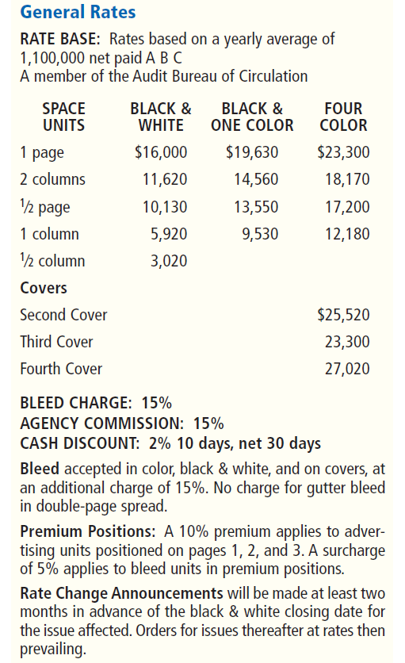
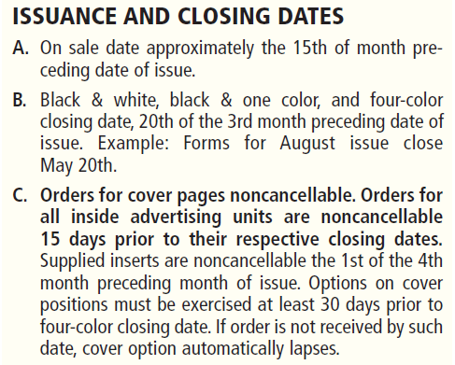

Slide 25
Calculating a rate to run an ad in a magazine
1 page
full color
Bleed
using an agency
payment terms 2/10 net 30
What would your CPM be if
this magazine has a circulation
of 250,000?
23,300.00
x 1.15
26,795.00
x .85
22,775.75
x .98
22,320.24
22,320.24/250
CPM = 89.28

Slide 26
How much for the ad and the CPM?
Full color
Back cover
Bleed
Payment terms 2.5/10 net 30
Circulation is 300,000
23,300.00
x 1.15
26,795.00
x .975
26,125.13
26,125.13/300
CPM = 87.08

Slide 27
Internet Rates
Based on the type of display format desired
Banner Ads
Mini
Midrange
Vertical or horizontal
Floating
Expandable
Rich media ads
Pop up and pop under ads
CPM rate is based on page monthly page views
Pay for sale links
Other businesses links on your website
Notes:
Pay for sale link commissions paid only when actual sales are made through the link

Slide 28
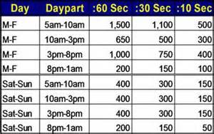
Radio Rates
Network radio
Broadcast from a studio and
carried on affiliated stations
National radio
NPR
Local radio
Only serves a local area
Spot radio
Refers to the geographical area an advertiser wants to reach
Spot commercials
are advertisements of 1 minute or less that can be carried on national or local radio
Notes:
ROS is an option – Run Of Schedule. The station decides when to run the ad over the contracted period

Slide 29
Television Rates
Vary depending on the time and day
What show that it runs during
Live Sports are the most expensive
Normally based off ratings
Cardinals game is anywhere from million to 50 thousand
Prime time 7 pm to 10 pm
Day 9 am to 4 pm
Late fringe 10:35 pm to 1 am
Overnight 1 am to 5 am

Slide 30
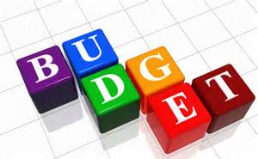
Promotional Budget
This budget considers ALL costs
Developing, placing and airing the ad
Staffing the department or advertising campaign
Percentage of Sales
Based on a percentage of anticipated sales – say 5%
All you can afford
Business pay all expenses then applies the remainder to promotional efforts
Following the competition
Based on what the competitions market share is
Objective and task
Identifies company goals, how they will be reach, how much they will cost
Notes:
All you can afford is used only for a short period of time and is primarily used by small businesses in order to quickly build sales and a reputation
Objective and task is the most effective because it focuses on the company’s goals and how it will reach them

