Slide 1
Objectives
Explain the concept and purpose of visual merchandising
Identify the element of visual merchandising
Describe types of display arrangements
Understand the role of visual merchandisers on the marketing team
List the five steps in creating a display
Explain how artistic elements function in display design
Describe the importance of display maintenance

Slide 2
SECTION 18.1 – Display Features
The Main Idea
Visual merchandising and displays are important promotion strategies to sell products and services, attract potential customers, and create a desired business image
“The appearance of buildings and store interiors are promotional strategies to sell products and services”

Slide 3
Visual merchandising and Display
Visual merchandising
Coordinates all of the physical elements in a place of business to project an image to customers
Attracts customers
Creates an image
Promotes interest in product/service
Display
Refers to the visual and artistic aspects of presenting a product to a target market to encourage a purchase
Notes:
Visual merchandising includes the visual and artistic aspects of the entire business environment
A successful business creates a distinct, clear, and consistent image for their customers – sets them apart from their competition
Includes design and layout of the store, its logo and signage, the unique lines of products a store carries. Their website, ad campaigns also.
a good image will attract positive attention and loyal customers

Slide 4
The Role of Visual Merchandisers
Responsible for the total merchandise presentation that builds business and brand image
Design, create, and maintain the design element of the building and display.
They promote a business’s image and sales
To attract customers and keep them coming back
An inviting and engaging selling space
Consider 4 elements as key to achieving these goals

Slide 5
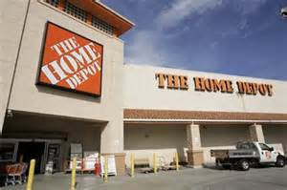
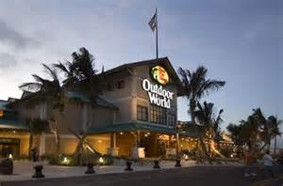
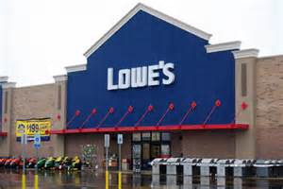
Storefront
The exterior of the business
Outdoor lighting
Landscaping
Banners
Awnings
Unique storefronts build brand identity
Sets a business off from its competitors and surrounding stores

Slide 6
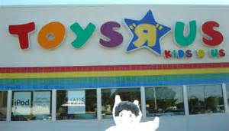
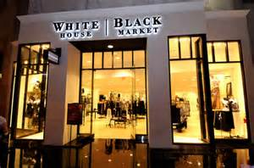
Signs
Designed to attract attention and brand identity
Should be original and easily recognizable
Name, Letters, Logo, Materials and Colors

Slide 7
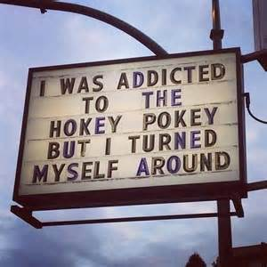
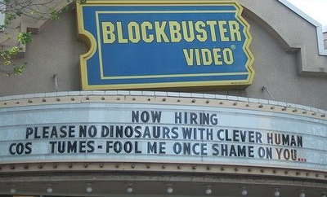
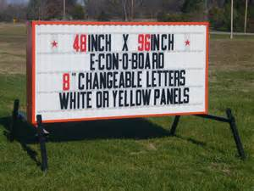
Marquee
A canopy that extends over a store’s entrance
Highly visible space used for advertising
Shows:
Store name
Key products
Hours of operation
Phone number and website

Slide 8
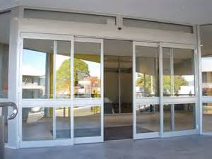
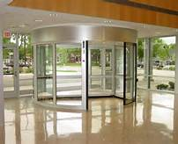
Entrances
Designed with customer convenience and store security in mind
Should have two entrances
One for walk ins and the other from
the parking lot
Projects an image
Electric doors = self serve
Fancy = full service

Slide 9
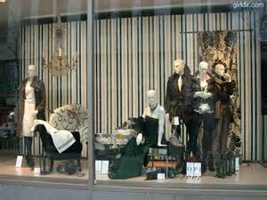
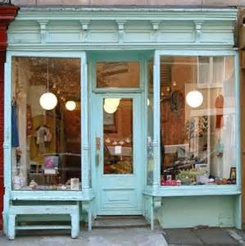
Window Displays
Very useful for visual merchandising
Attract prospects
Create excitement for product on supply
“window shopping”

Slide 10
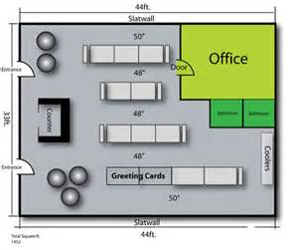
Store Layout
Refers to ways that store use floor space to facilitate and promote sales and serve customers
Selling Space – displays, merchandise, and demonstrations
Storage Space – stockrooms or place inventory is kept
Personnel Space – office space and break room,
Customer Space – seating and lounges
Notes:
Selling space is used for interior displays, wall and floor merchandise, product demos, self service, sales transactions and aisles for customer traffic flow
Storage space is for items that are kept in inventory or stock rooms. Typically not seen by customers
Personnel space is for store employees – office space, break rooms, and restrooms
Customer space is designed for comfort and convenience of the customer and may include snack shops, seating, lounges and rec areas for kids

Slide 11
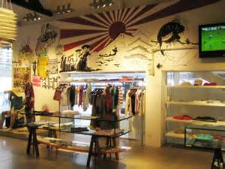
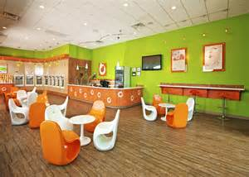
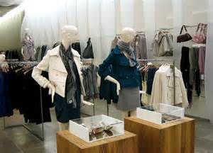
Store Interior
Once placement of merchandise is determined
Mannequins
Decorations
Seating
Innovative props
Floor and wall coverings
Lighting
Colors
Store fixtures
Graphics

Slide 12
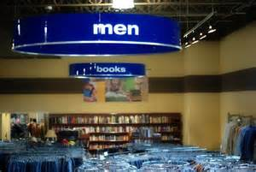
Graphics, Signage, Color and Sound
These help promote a particular brand or product
Provide directions to various departments
Assist with special promotions
Colors and sound
Appeal differently to customers
Sound can set a mood and will encourage shopping
Reinforces an image of a brand or product

Slide 13
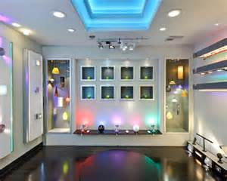
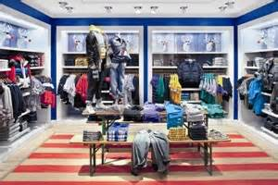
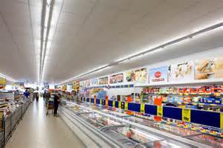
Lighting
Draws attention to store area
Draws attention to specific products

Slide 14
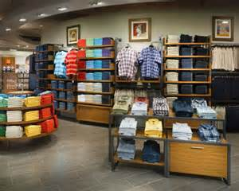
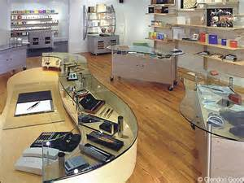
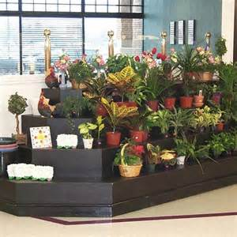
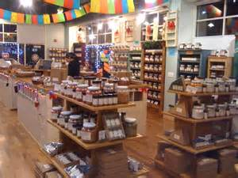
Fixtures
Are furnishings that hold and display merchandise
Cases
Tables
Counters
Floors
Shelving
Racks
Bins
Notes:
Strategically place to generate sales
Brightly colored front counters attract impulse purchases of competitively priced products
Seating areas give a retail space and upscale feel

Slide 15
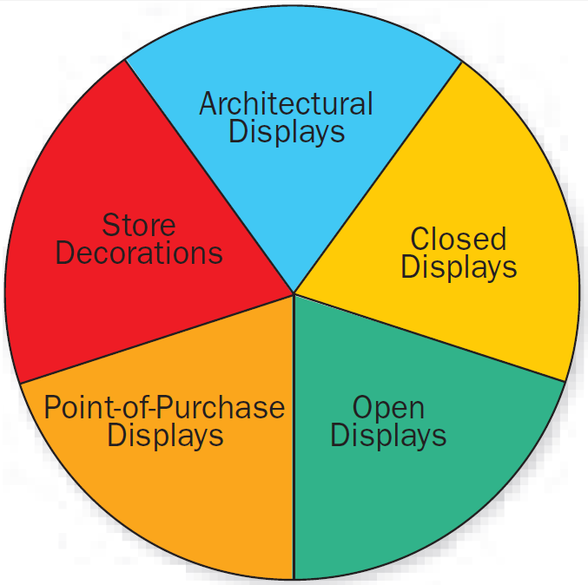
Interior Displays
Show merchandise
Encourages shopping
Reinforces advertisements
Promotes the store image
About 25% of sales are
are generated by interior
displays

Slide 16
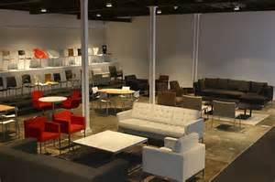
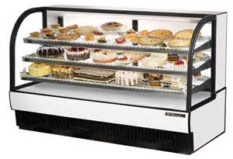
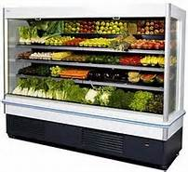
Architectural Displays
Model rooms for show
Kitchens
Family rooms
bedrooms
Closed Displays (1 to 1 selling)
See but not touch
Jewelry & electronics
Fragile items
Open Displays (DIY selling)
Allows customers to handle product

Slide 17
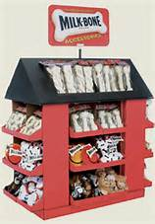
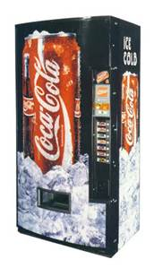
Point of Purchase Displays (POPs)
Stand alone structures
Consumer sales device
Bold graphics
Hold, display and dispense product
Encourages immediate purchase
Temporary
Semi Permanent
Permanent

Slide 18
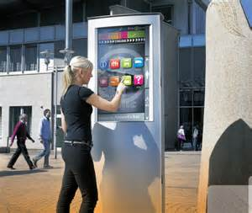
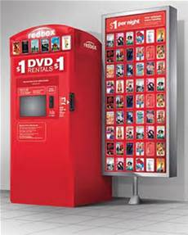
Interactive Kiosks
Free standing full service retail
Immediate product availability

Slide 19
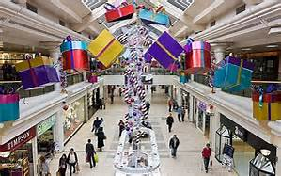
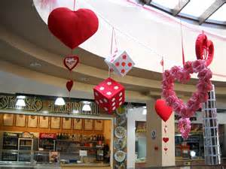
Store Decorations
Seasonal
Bold and colorful
Sets an atmosphere
Encourages related holiday purchases

Slide 20
SECTION 18.2 – Artistic Design
The Main Idea
Visual merchandisers must know the rules of artistic design to create displays that enhance sales, attract customers, and sustain customers loyalty
“In the retail environment a display has about 4 to 6 seconds to attract a customer’s attention, create a desire, and sell the product”

Slide 21
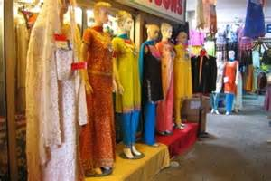
Display Design and Presentation
Visual merchandisers help attract customer and sell products
Sensitive to individual perceptions
Appeal to targeted customers
5 steps
Notes:
If a traditional clothing store starts using an abstract displays of trendy products it may attract new customers but may lose loyal customers who prefer the more traditional styles.

Slide 22
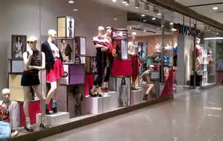
Step1: Select Merchandise for Display
Determine a theme
Supporting elements
Visually appealing
New, popular & best selling
Appropriate for season
Target audience
Geographic location

Slide 23
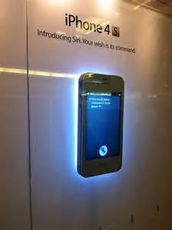
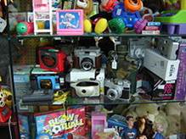
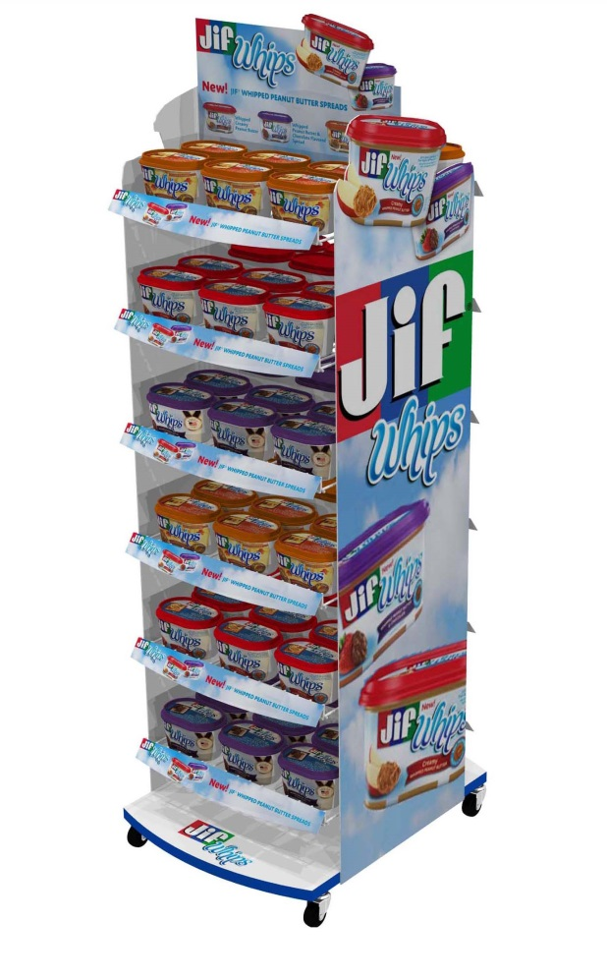
Step 2 : Select the type of Display
One-item Display
Similar-product Display
Related-product Display
Assortment or Cross-mix Display
Props – functional and decorative
Shelves or hangers that hold merchandise
Floor coverings and wall treatments
Notes:
Single item is usually created for a single product or an advertised special
Similar-product how one kind of product but with multiple flavors and sizes and even brands
Related product features products that are to be used together – to entice buyers to buy more than one item.
Assortment features a collection of different or unrelated items designed for the bargain hunter

Slide 24
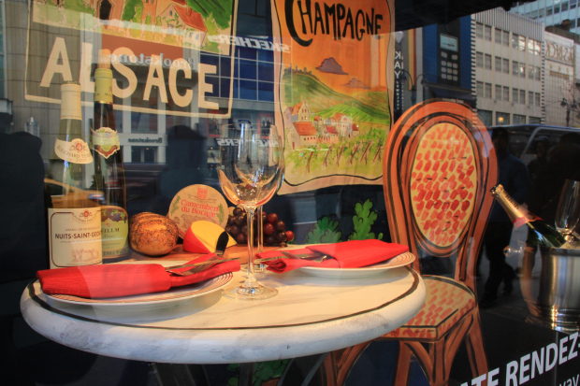
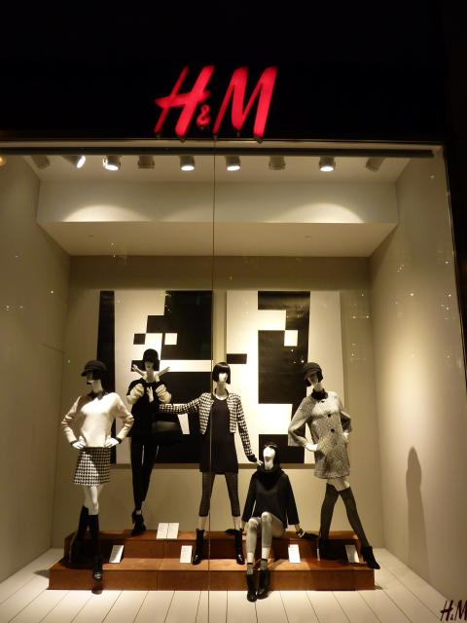
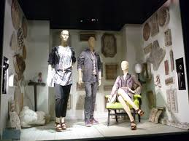
Stet 3 : Choose a Setting
Realistic Setting
Semi-realistic Setting
Abstract Setting
Notes:
Realistic depicts a room, area or recognizable locale
Restaurant, park or a party
Functional props like tables, chairs, plants, books, mannequins provide the details
Semi realistic suggests a room or locale but leave the details to the view
Cardboard sun, a bucket of sand leads the viewer to provide the beach
Used for small spaces or budgets
Abstract does not even try to imitate reality
More of focus on form and colors

Slide 25
Step 4 : Manipulate the Artistic Elements
Line
Straight lines – stiffness and control
Curving Lines – freedom and movement
Diagonal Lines – action
Vertical Lines – height and dignity
Horizontal Lines – convey confidence
Notes:
Lines direct the viewer’s attention – straight, curved, diagonal, vertical, horizontal
Color can emotionally engage a customer to make a decision – use contrasting colors
Complimentary, adjacent and triadic colors
Certain color schemes at certain times of the year
Shape
Direction – directs the viewer eyes to the merchandise. The focal point attracts the attention first. Triangle shape. Too much clutter in the triangle is said to be unfocused
Texture
Proportion – props and signs should be in appropriate size to the merchandise
Balance – formal and informal
Lighting – can help merchandise appear more attractive

Slide 26
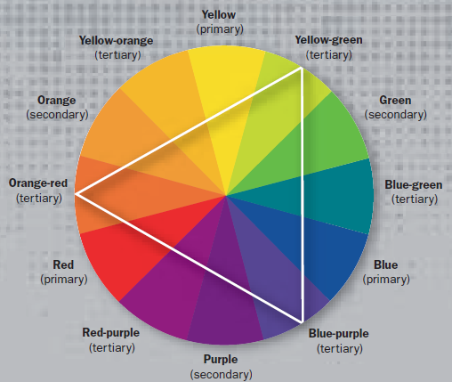
Color
Color Wheel – relationships among colors
Complementary – opposite of each other and create a high contrast
Adjacent (analogous colors)- located next to each other on the color wheel and are the same undertones
Triadic – involve 3 colors equally spaced on the color wheel

Slide 27
Shape
Physical appearance or outline – squares, cubes, circles, & triangles
Mass displays
Have little or no distinct shape
Direction
Created by using techniques such as color repetition, and lighting patterns
Focal point
An area that attracts the attention first
Texture
The look of the surfaces in a display
Proportion
Relationship between and among objects in a display

Slide 28
Balance
Formal balance – small items with small items
Informal balance – designers place several small items with one large item within the display
Motion
Should be used sparely but it can be achieved a lot of different ways
Lighting
Display lighting should be 2 to 5 times stronger than the general lighting

Slide 29
Step 5 : Evaluate the Completed Display
Does the display enhance the stores image?
Does it promote the product in the best possible way?
Was the theme creatively applied?
Was the result pleasing?

Slide 30
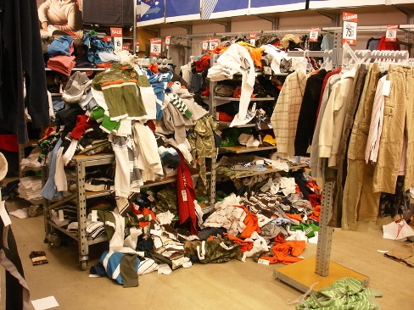
Display Maintenance
Restock
Folded and arranged
Fix damaged prop
Clean

