Slide 1
Objectives
Explain the role of promotion in business and marketing
Identify types of promotion
Distinguish between public relations and publicity
Explain the element of a news release
Describe the concept of the promotional mix
Define sales promotion
Explain the use of promotional tie-ins, trade sales promotion, and loyalty marketing programs

Slide 2
SECTION 17.1 – The Promotional Mix
The Main Idea
The combination of personal selling, advertising, direct marketing, sales promotion, and public relations makes up the promotional mix.

Slide 3
Promotion is any form of communication a business uses
to inform, persuade or remind people about products and services
to improve the public image of an organization
Educate the public about an issue, trend or to advocate a change in law or policy
Goal of Promotional Communication Process
AIDA
Attract Attention
Build Interest
Desire
Ask for Action
Notes:
Refer to Oscar Meyer Example on page 300

Slide 4
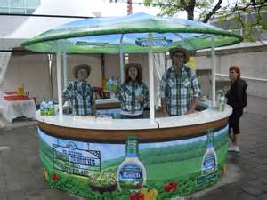
Product Promotion
Convince potential customers to select your product or service
Explains major features and benefits
Identify where it is sold
Advertise sales
Answer customer questions
Introduce new offerings
Foster customer loyalty

Slide 5
“Companies use promotion to build awareness and inform people about their products”

Slide 6
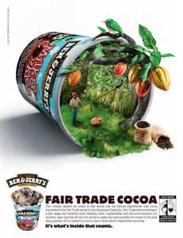
Institutional Promotion
Create a favorable image for a company
Favorable image often improves sales efforts
Help it advocate change
Take a stand on trade or community issues
Does not directly advertise the
product
Web sites are used to provide
news, product and other
information and answer questions

Slide 7
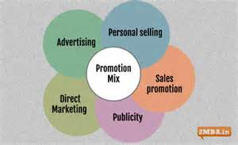
Promotional Mix
Promotional Mix is the cost effective combination of the different types of promotion
Person Sales
Advertising
Direct Marketing
Sales Promotion
Public Relations

Slide 8
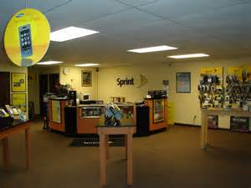
Personal Selling
Requires direct contact with the customer
One of the largest forms of promotion
Most expensive form of promotion
Completes the sale after the customer has been attracted by other types of promotion such as advertising, sales promotion & public relations
Two-way communication between buyer & seller

Slide 9
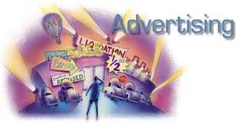
Advertising
Any paid form of non-personal presentation and promotion of ideas, goods or services by an identified sponsor
Involves one-way communication
Includes magazines, newspapers, television and Web sites, city buses, etc.
Businesses spend approximately $200 billion annually on advertising

Slide 10
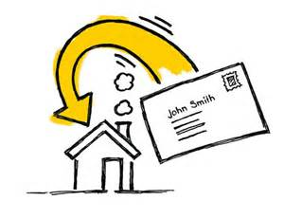
Direct Marketing
Advertising directed to a targeted group of prospects
One way communication
Two forms: Printed and Electronic
Goals:
Generate leads for sales
Elicit response from the customer by making a special offer
Congress passed CAN-SPAM act
Notes:
CAN_SPAM act requires senders of unsolicited commercial e-mail to give recipients a way to opt out of e-mails
Also prohibits the use of deceptive subject lines and headers.
Also requires businesses to provide valid return addresses on their-mails

Slide 11
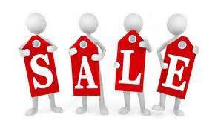
Sales Promotion
All marketing activities, except personal selling, advertising and public relations, that are used to stimulate consumer purchasing and sales effectiveness.
Objectives are to:
increase sales
inform customers about new products
create a positive store or corporate image

Slide 12
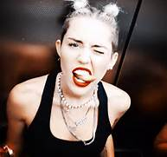
Public Relations and Publicity
Public relations is any activity designed to create a favorable image towards a business or its products.
Sponsoring cultural and charity events
Awarding scholarships
Donating money and product to causes
Publicity is a kind of public relations that involves placing positive information about a company or products in the media.
Advantages - It’s FREE and is viewed as more objective & credible than advertisements
Disadvantage - It cannot be controlled
Notes:
Cost is not the only advantage of publicity. All media and customer generated responses through social media are usually viewed as more objective than advertisers
People are more likely to pay attention to and believe news stories and customer feedback than advertisements
Publicity is unpaid and therefore not controlled by the business

Slide 13
Public Relations: News Release
One of the most important media tools
News Release is an announcement sent to media outlets regarding:
Developments of company’s products and services
Facilities and operations
Partners
Revenues and earning
Employees
Events
See page 398 for an example
Public Relations
News Release
Social Media
Publicity

Slide 14
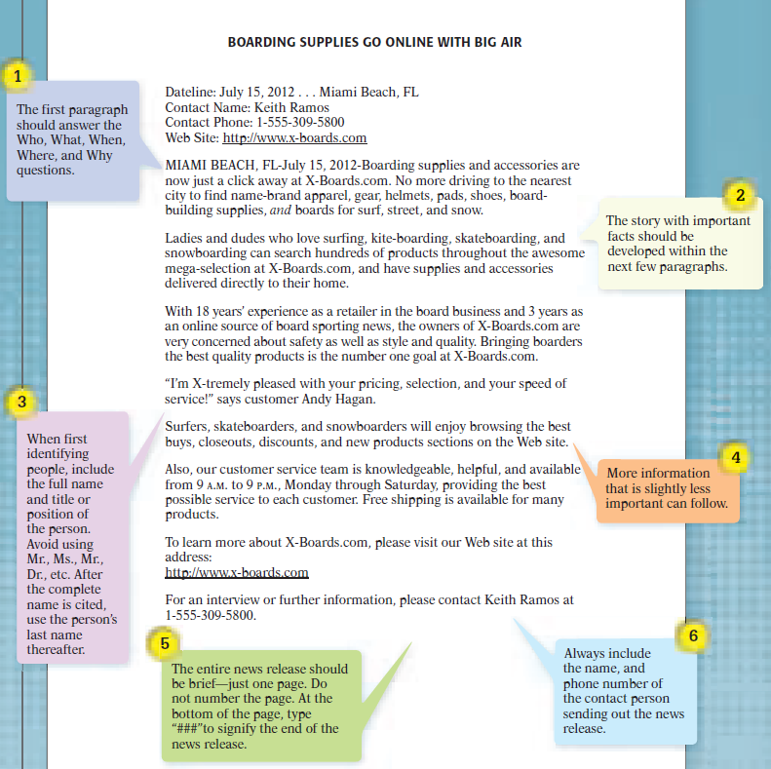

Slide 15
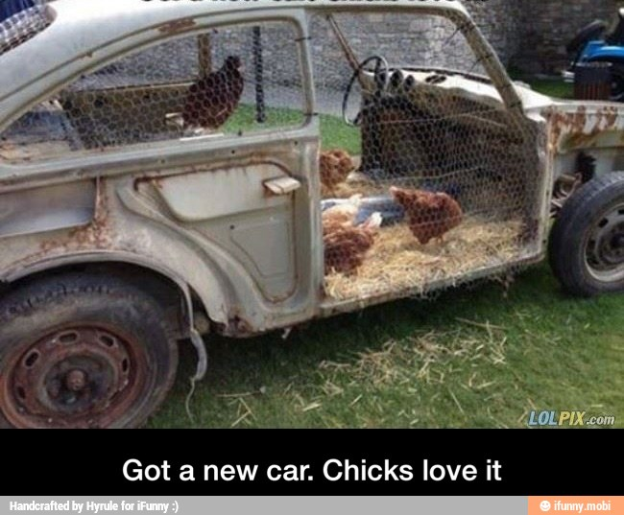

Slide 16
Coordination of Promotional Mix
Each type of promotion compliments the other
Advertising creates awareness
Public relations creates a favorable image
Sales promotion stimulates sales, reinforces advertising and supports selling efforts.
Personal selling helps complete the sale
It is important to take all of these activities into account when developing a promotional budget
Notes:
Companies use more than one type of promotion to achieve their sales goals
The mix assures that their product will be recognized and only then will the product be easier to sell and generate revenue.
Ongoing and contiuous – information that is learned in one cycle of the mix is applied to the next cycle

Slide 17
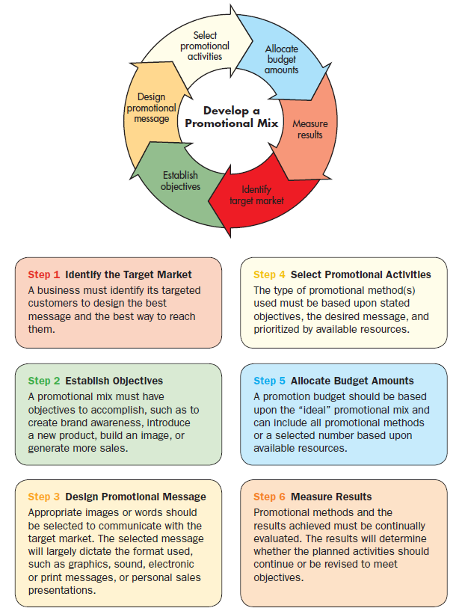

Slide 18
Promotional Activities
Realistic
Coordinated
Complement each other
Build awareness
Reach the target market
Create sales
Measured for results

Slide 19
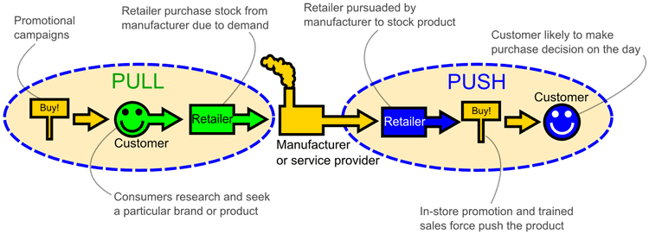
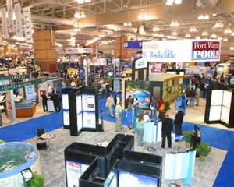
Push-Pull Concept
Push Policy
Manufacturer pushes the product into the retailer
Promotion is directed to members of the distribution channel
Relies heavily on personal selling and sales promotion
Trade shows and trade discounts
Notes:
The push strategy is useful for manufacturers whose products do not have a strong brand identify
The products are pushed through the distripution channels by the manufacturers

Slide 20
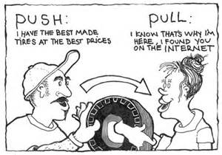
Pull Policy
Directs promotion towards customers
Designed to created customer interest and demand to pull retailers into carrying the product
Relies heavily on advertising as well as premiums, samples and demonstrations.
Half off and clearance sales
Notes:
The pull policy of promotion is designed to create consumer interest and demand. Consumer demand pulls the product through the distribution channel by encouraging wholesalers and retailers to carry a product

Slide 21
SECTION 17.2 – Types of Promotion
The Main Idea
Sales promotions include different techniques to increase sales and inform customers about a company’s products

Slide 22
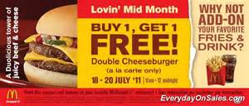
Sales Promotion
A short term incentive offered to encourage buying a good or service
Purpose is to:
Increase demand and stimulate sales
Encourage customers to try new products
Build awareness
Increase purchases by current customers
Reward loyalty
Notes:
AN OLD PROVERB
A tiger asked a lion as they drank beside a lake, “Why are you always roaring? It’s an awful noise to make.”
Between his roars the lion said, a twinkle in his eyes, “Because I am King of the Beasts and it pays to advertise?”
A rabbit, overhearing, said, “I’m tired of being meek, I think I’ll try the lion’s plan.”
But his roar was just a squeak.
The lion heard the squeaking and had lunch in the wood
Moral of the story is: If you don’t have the goods, don’t advertise

Slide 23
“Sales promotions may be either business-to-business (B2B) or business-to-consumer (B2C) activities”

Slide 24
Sales Promotion
Can be directed to all members of the channel of distribution and a company’s sales force
Manufacturers Wholesalers Retailers Consumers
Usually supported by advertising activities
May be Trade Oriented (business to business) or Consumer Oriented (business to consumer)

Slide 25
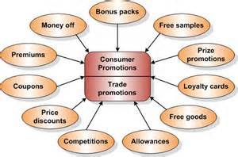
Trade Promotions
Sales promotions designed to get support for a product from manufacturers, wholesalers and retailers
More money spent promoting to businesses than consumers
Major Trade Promotions include:
Promotional Allowances
Cooperative Advertising
Slotting Allowances
Sales Force Promotions/Incentives
Trade Shows and Conventions
Notes:
Good business ethics require that trade promotional payments and award be offered in a uniform manner. It also requires that terms be clearly spelled out and that no one is penalized for not achieving the goals.

Slide 26
Major Trade Promotions
Promotional Allowance
Price discount or cash payments given to wholesalers or retailers for performing activities to encourage sales
Cooperative Advertising
Manufacturer helps pay for advertising its product locally
Slotting Allowances
Cash premium paid by a manufacturer to a retailer for costs to put product on its shelves
Can range from a few thousand dollars to over a few million
Notes:
Promotional allowances are sometimes used to encourage wholesalers or retailers to stock a large quantity of a product. The cash payment or prince discount gives wholesalers and retailers an incentive to sell, therefore they are more likely to promote the product.
Slotting Allowances pay for retailers discount specials, charges for store shelves, penalties for poor sales, store advertising, and display costs

Slide 27
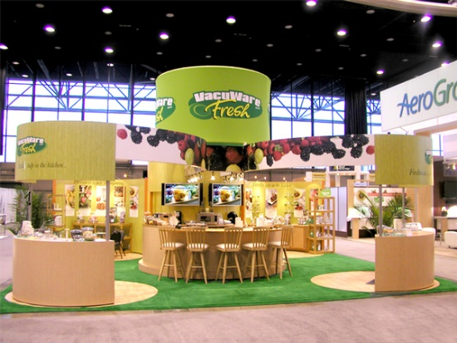
Major Trade Promotions (cont.)
Sales Force Promotions
Awards given to managers and employees who meet or exceed sales quotas
May include prizes such as merchandise, travel or cash
Trade Shows and Conventions
Designed to reach wholesalers and retailers
Provide opportunities to introduce new products, increase sales and gain continued support

Slide 28
Consumers Sales Promotions
Sales promotions designed to encourage consumers to buy a product
More than half the households in the US take advantage every year
Major Consumer Sales Promotions include:
Coupon – Deals
Premiums – Loyalty Marketing programs
Sponsorships – Promotional Tie-ins
Incentives – Product Placement
Product Samples – Visual Merchandising

Slide 29
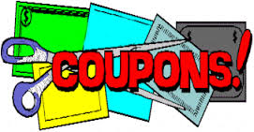
Coupons (Most popular premium)
Certificates that offer cash discounts
Used to introduce new products
Used to enhance the sales of existing products
Encourages retailers to stock and display both
Placed in or on packages, in newspapers and magazines
Limited time with value that expires

Slide 30
Premiums
Low cost items given to consumers at a discount or free
Designed to increase sales by building product loyalty and attracting new customers with added value
Factory Packs or in-packs
Free gifts placed in/on product packages or as a container
Traffic Builders
Low cost premiums such as free pens, key chains and calendars
Given away for visiting a new store or special event
Coupon Plans
On-going programs offering a variety of premiums for collecting labels, coupons, points or tokens for redemption for gifts
Notes:
Premiums are designed to motivate to buy a product when offered a gift in exchange.
Factory packs – the kids that plays with the toy from the cereal box gets a positive impression of both companies
When a customer uses the premium he is reminded of the company and the experience
One drawback to using premiums is that customers may think they are disposable. It is important for a company to not flood customers with too many premiums. This practice increases the chances that the premiums will be discarded

Slide 31
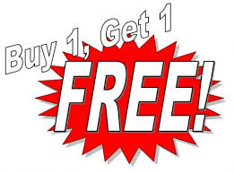
Deals
$10.50 each or 2 for $12.00
Incentives
Generally higher priced products awarded through contests, sweepstakes and rebates
Contests are games of skill
Sweepstakes are games of chance
Rebates are discounts for purchasing during a specific time

Slide 32
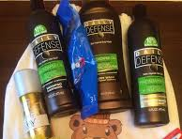
Product Samples
A free trial size
Hygiene products
Sponsorship
Involves the promotion of a company in association with a property such as a stadium, hospital, museum or performing arts center
Title Sponsor has the name of the company incorporated into name of property (i.e. Scott Trade Center)

Slide 33
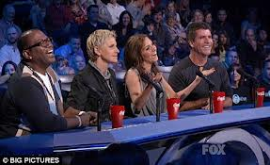
Promotional Tie-ins / Cross Promotion / Cross-Selling
Involve sales promotional arrangements between one or more retailers or manufacturers
Partners combine activities to create additional sales for both
Example: Disney, McDonalds and Fisher Price to promote a new animated movie
Product Placement
Develop product recognition by featuring it in special events on television or in the movies
Ford cars on the Amazing Race

Slide 34
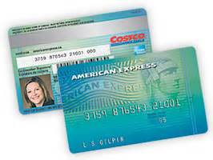
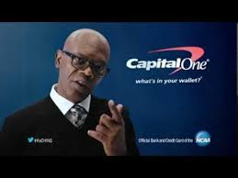
Loyalty Marketing Programs
Frequent buyer, reward or shopper programs
Reward customer by offering incentives for repeat purchases
Online Loyalty Programs
Points for shopping on line
Turned into airline tickets
Email notices of exclusive sales

Slide 35
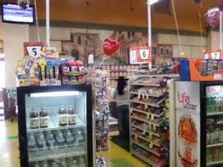
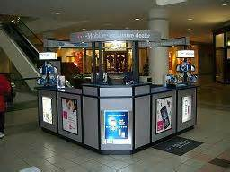
Point of Purchase Displays
Displays designed primarily by manufacturers to hold and display product
Placed in high traffic areas
Promote impulse purchases
Includes window, counter and in-store displays
Kiosks – point of sale displays

