Slide 1
Objectives
Explain the purpose and goal of the selling function
Discuss how selling is related to the marketing concept
Discuss Customer Relationship Management (CMR)
Analyze sales trends and technology
Summarize sales management responsibilities
Explain legal and ethical sales issues
Define personal selling
Identify sales positions
List the steps in the sales process
Analyze how customers make buying decisions
Evaluate selling as a career option

Slide 2
SECTION 12.1 – The Sales Function
The Main Idea
The marketing concept comes alive in the sales function with the help of emerging trends and technology. Customer Relationship Management (CRM) and sales management efforts help to achieve the purpose and goal of selling
“No company can stay in business if its products do not sell.”

Slide 3
Selling and Marketing Concept
Selling is important to the marketing function because it generates the revenue that a business needs to operate
Purpose and Goal
Help customers make satisfying buying decisions
Create on going profitable relationships
Has created a customer-centered focus that companies have embraced.
Marketing, customer service and technology work together
Notes:
Customers visits the company website and requests product information
Customers service gets the request handles it and forwards to the sales department for follow up
Information obtained is used by the sales staff to be better prepared to solve the customers problem

Slide 4
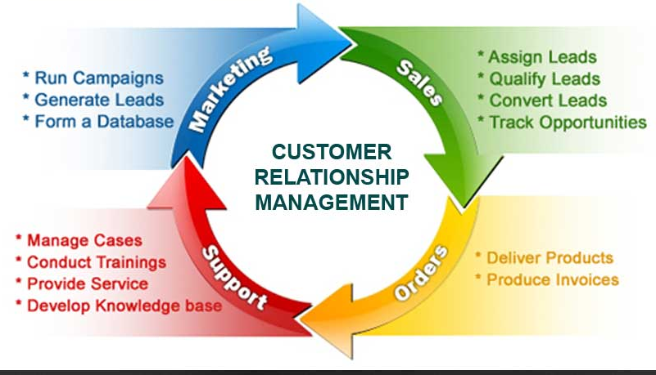
Sales Trends and Technology
Identifying needs is profitable
Involves finding and keeping customers
Flourished with computers
Web site and emails help businesses keep in contact with their customers

Slide 5
Web Sites and Social Media
Provides product information
Some designed for purchases
Others designed to tell users where to purchase
Provides information to current and potential customers
Provides contact information
National and global accessibility
Email
Quick, efficient contact
Captures customer data
Solidifies relationships
before and after the sale

Slide 6
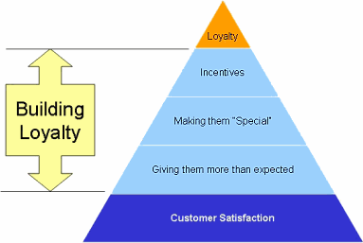
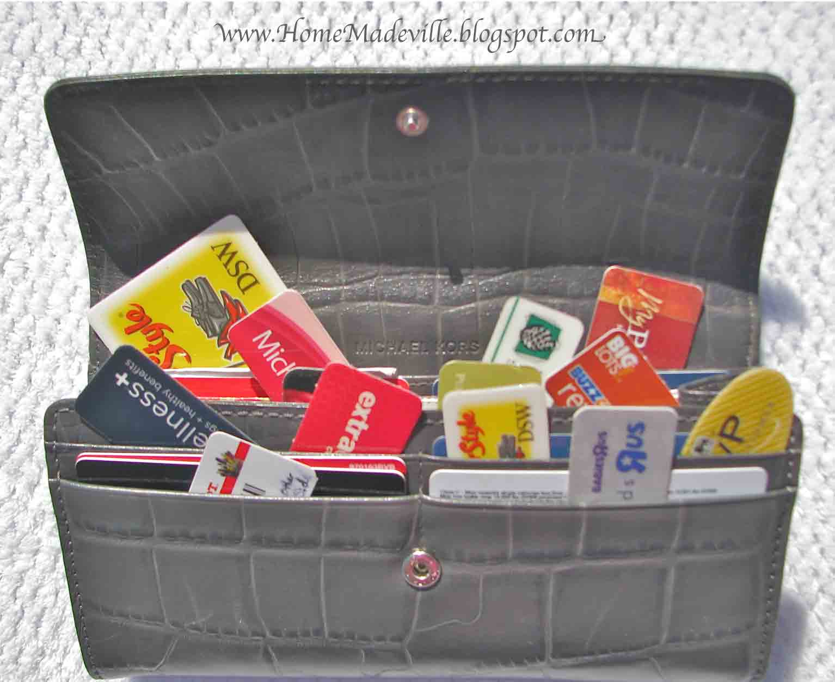
Customer Loyalty Programs
Computer Software
Sales automation
Sales territory management
Sales forecasting
Compensation and incentive management

Slide 7
Mobile Devices
Allows for constant connectivity
Interfaced with company servers
Partnerships
Companies partner to provide total
enterprise solution (hardware/software)
Extensive training of salesforce
Built on trust and commitment
Requires time and effort to maintain

Slide 8
Sales Management
Company Policies
Training
Sales Management
Policies
Training
Compensation & Sales Quotas
Legal & Ethical Issues

Slide 9
Compensation and Sales Quotas
Legal and Ethical Issues

Slide 10
Sales Pressure
Sales Contracts
Sales Regulations

Slide 11
SECTION 12.2 – Sales Career
“Personal selling involves two-way communication between the buyer and seller.”

Slide 12
Personal Selling
Types of Sales Positions
Retail Business
Industrial and service Business
Telemarketing and nonprofit
Internet websites and sales
Types of Position
Retail
Industrial & Service
Online
Telemarketing & Nonprofit

Slide 13
Step of a Sale
Notes:
Approach the customer – greeting the customer face to face
Determine needs – learning what the customer is looking for in order to decide what product to show and which product features to present first in the next step of the sale
Present the product – educating the customer ab out the products features and benefits, as well as it advantage over the competition
Overcome objections – learning why the customer is reluctant to buy, providing information to remove that uncertainty and helping the customer to make a satisfying buying decision
Close the Sale – getting the customers positive agreement to buy
Perform suggestion selling – suggesting additional merchandise or services that wll save your customer money or help your customer better enjoy the original purchase
Build Relationships – follow up by creating a means of maintaining contact with the customer after the sale is compete

Slide 14
Customer Decision Making
Extensive Decision Making
Limited Decision Making
Routine Decision Making

Slide 15
A Career In Sales
Sales Career Benefits
Characteristics of Successful Sales People
Honest
Good Interpersonal Skills
Problem Solving Skills

